Slide 1
Emberyogenesis of the heart and great blood vessels

Slide 2
Objective
To know when and how the heart and great blood vessels are developed.
To understand the embeylogical bases of congenital heart disease.

Slide 3
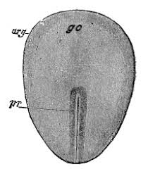
Early emberyogensis

Slide 4
Formation of cardioblast, cardiocytes, clustering and migration

Slide 5
Formationof cariogenic plate, primitive heart tubes

Slide 6
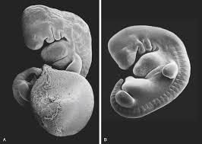
Folding of the emberyo

Slide 7
Fusions of primitive heart tubes
Formation of single primitive heart tube

Slide 8
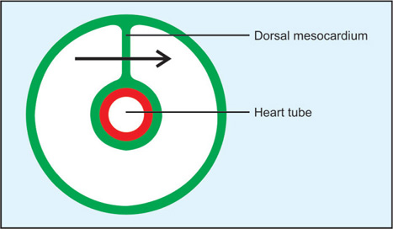
Further

Slide 9
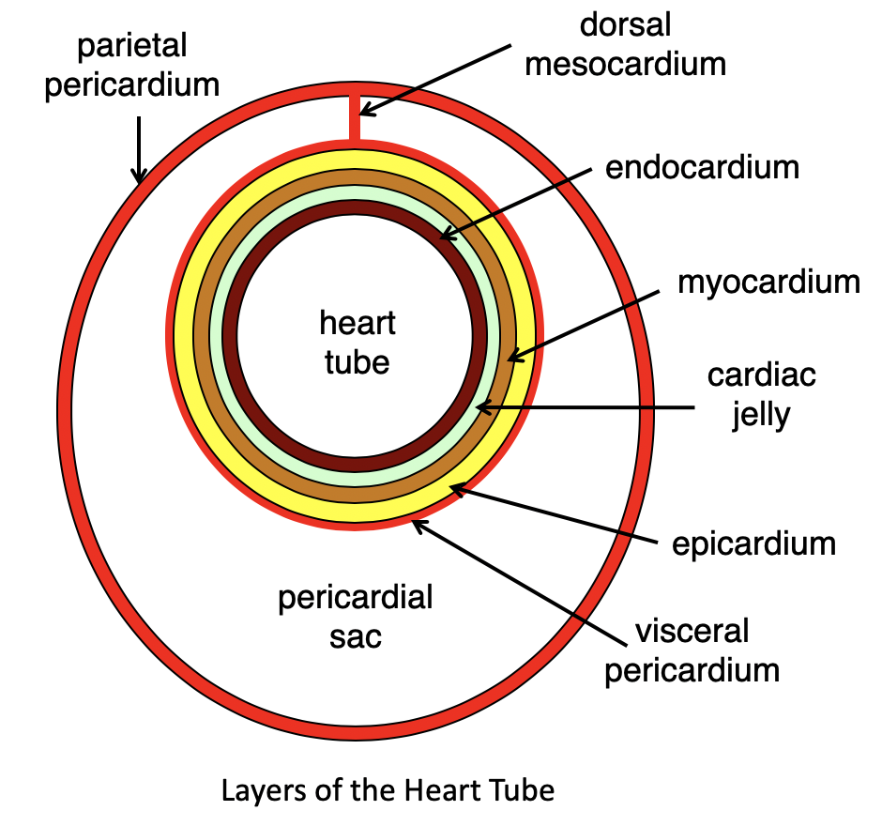
3 cell layer

Slide 10
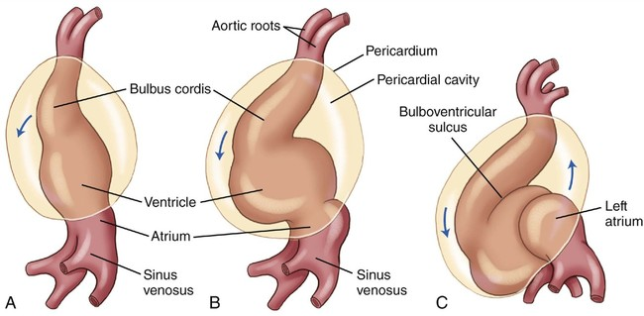
Heart tube looping, mechanism, direction, cardiac position

Slide 11
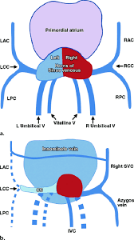
Development of sinus venosus

Slide 12
Atria
Anterior trabiculated.
Posterior smooth
Cresta terminalis

Slide 13
Atrial seption
At the end of 4th week of gestaion
Septum Primum
Endocardial cushions
Ostium primum.
Septum secondum
Ostium secondum.
Foramin ovale

Slide 14
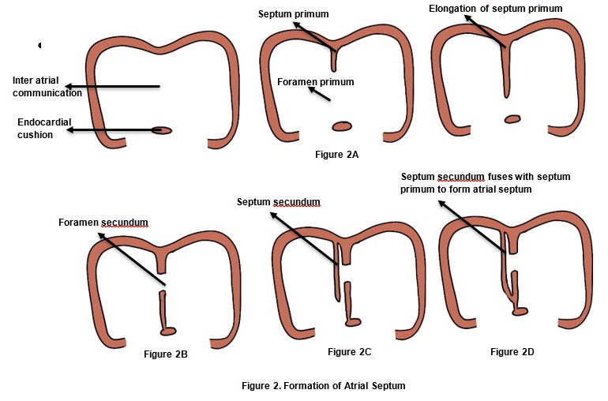

Slide 15
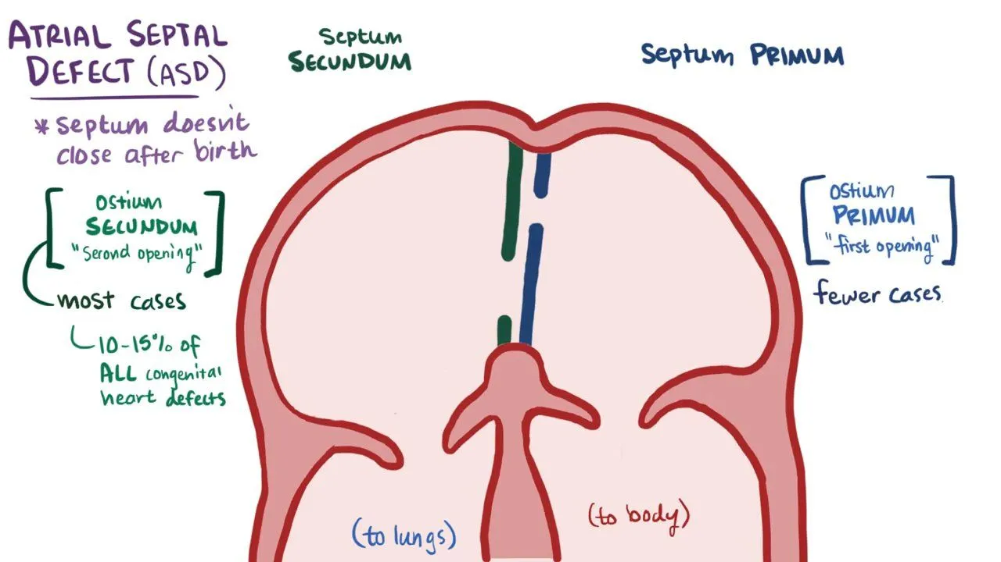

Slide 16
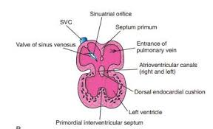
Septation of the ventricle

Slide 17
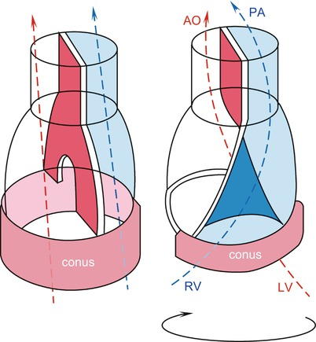
Septation of conus cordis

Slide 18
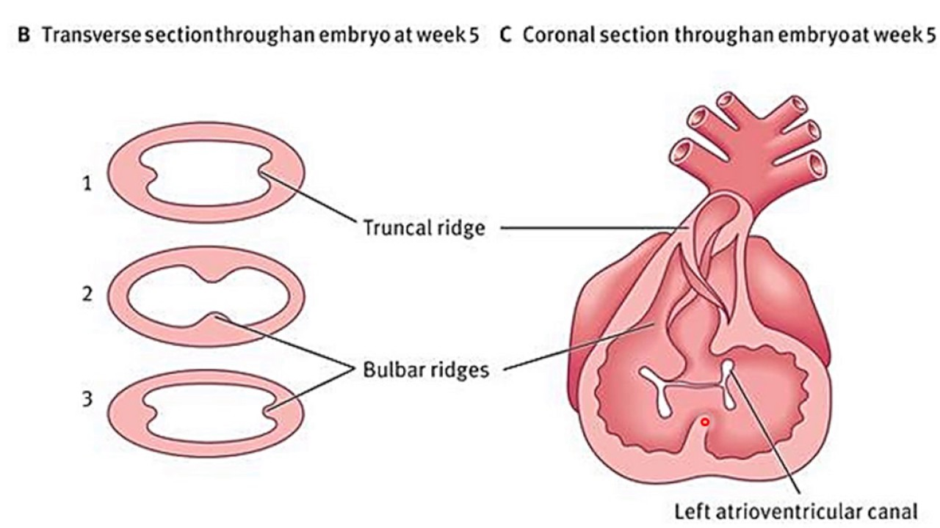
Septation of Truncus arteriosus

Slide 19
Development of great blood vessels

Slide 20
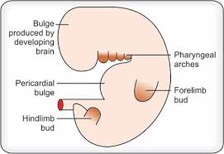

Slide 21
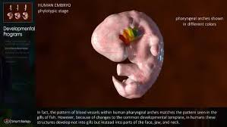

Slide 22
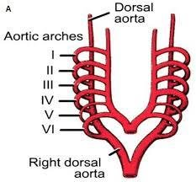

Slide 23
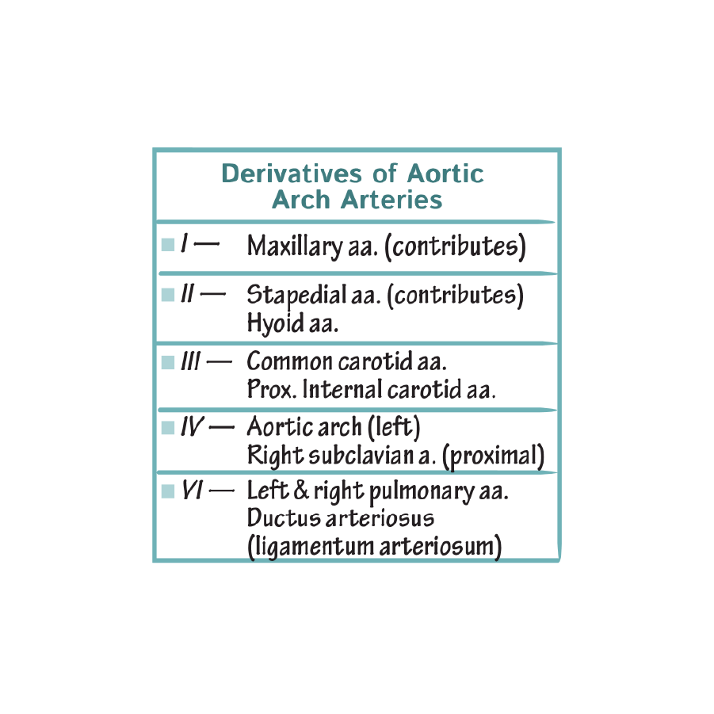

Slide 24


